Slide 1

DIGITAL ETIQUETTE

Slide 2

Digital etiquette refers to the proper and respectful way of behaving online. Just like we follow good manners in real life, we should also follow good manners on the internet when we communicate, share, or interact with others.

Slide 3
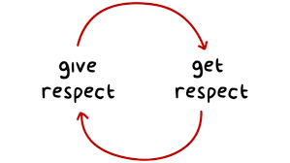
Be Respectful & Kind
Treat people online the way you would in person.
Avoid rude or offensive comments, even if you disagree.
Respect different opinions and respond politely.

Slide 4

Think Before You Post
Once something is online, it can be hard to remove.
Avoid sharing personal details like your address or passwords.
Don't post anything that could embarrass you or others in the future.

Slide 5

Use Proper Communication Style
Use professional language in emails and work messages.
Avoid using ALL CAPS (it looks like shouting).
Use emojis appropriately—too many can seem unprofessional.

Slide 6

Be Responsible with Information
Verify facts before sharing news or information to avoid spreading misinformation.
Cite sources if you're using someone else's content.
Do not plagiarize or copy others' work without credit.

Slide 7
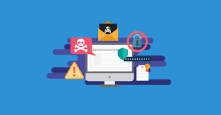
Respect Privacy & Security
Don't share someone else's personal information without permission.
Use strong passwords and enable security settings to protect your data.
Be careful while clicking on suspicious links to avoid scams or viruses.

Slide 8

Follow Workplace & School Rules
Use professional platforms appropriately (e.g., LinkedIn is for networking, not casual chats).
Follow company or school policies on internet usage.
Avoid using social media during work or class hours unless necessary.

Slide 9

Be Inclusive & Considerate
Avoid offensive jokes, discrimination, or hate speech.
Be patient with others, especially in online discussions or meetings.
Acknowledge different cultures and perspectives when communicating.

Slide 10
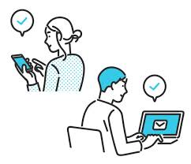
Why Digital Etiquette Matters?
Helps create a positive online environment.
Prevents misunderstandings and conflicts.
Protects your reputation and digital footprint.
Encourages respectful and professional online communication.

Slide 11
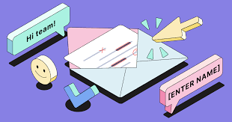
Example 1: Email Etiquette
Situation: You are emailing a colleague with a request.
Digital Etiquette: Begin the email with a respectful greeting, make the request clear but polite, and thank the recipient in advance for their time.
Incorrect Behavior: Sending a one-line email with no greeting or context, such as “Send me the report ASAP.”

Slide 12
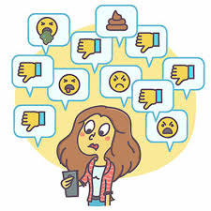
Example 2: Social Media Behavior
Situation: You see a friend post a photo of their family.
Digital Etiquette: Like the post or comment with something positive and supportive.
Incorrect Behavior: Posting unsolicited critical comments about their appearance or lifestyle.

Slide 13

Example 3: Online Forum or Group Discussion
Situation: Participating in a discussion about a topic you feel strongly about.
Digital Etiquette: Acknowledge differing opinions, provide clear arguments, and avoid name-calling or personal attacks.
Incorrect Behavior: Engaging in a heated argument, belittling others, or hijacking the conversation with unrelated comments.

